Slide 1


Couture Closet
By Team One

Slide 2

TEAM MEMBERS
01
02
03
RUI
iMRAN
doNALD OBI
Backend & DevOps
Project Manager & Frontend Lead
Lead Design & UI UX Architecture
04
05
Snigdha
partH
CEO / Developer
QA & Development

Slide 3


The client
Couture Closet, was born out of a passion for fashion, evolving from a small boutique to a thriving online store offering high-quality, stylish clothing for every occasion.

Slide 4
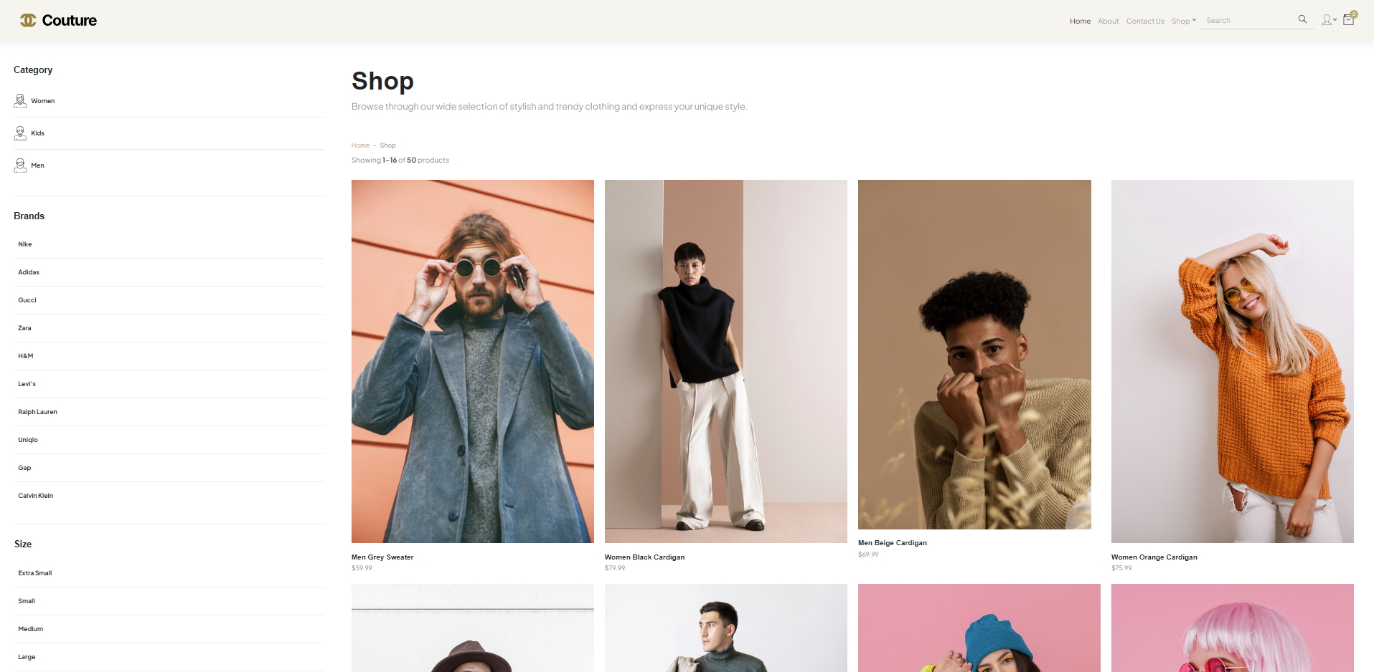
Listing & FILTERS

Slide 5
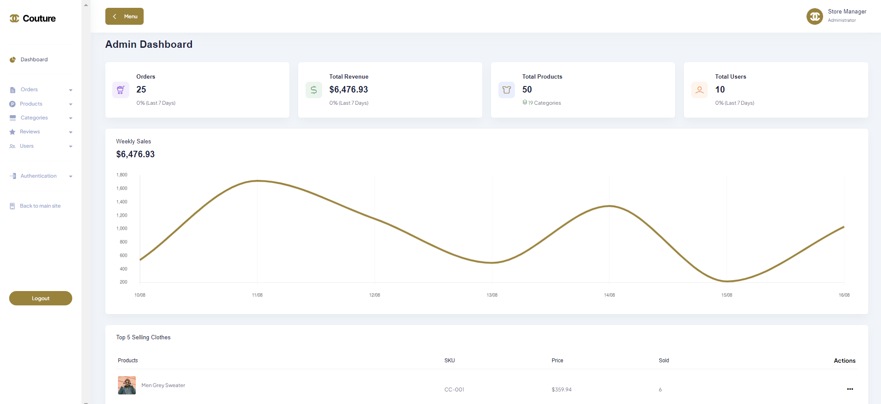
ADMIN DASHBOARD

Slide 6
products
id | bigint
sku | varchar(50)
name | varchar(100)
price | decimal(10,2)
stock_quantity | int
… | …
Database
Tables
orders
id | bigint
user_id | bigint
email | varchar(255)
total_amount | decimal(10,2)
shipping_address | text
… | …
01
The products table stores detailed information about individual clothing items, including their attributes and inventory status.
02
An "Order" table typically represents a transaction in which a customer purchases clothes from our online ecommerce website.

Slide 7
Database Tables
order_items
id | bigint
order_id | bigint
product_id | bigint
quantity | bigint
size | varchar(100)
unit_price | decimal(10,2)
line_price | decimal(10,2)
transaction
id | bigint
order_id | bigint
transaction_id | varchar(255)
transaction_status | varchar(255)
response | text
… | …
users
id | bigint
password | varchar(255)
first_name | varchar(255)
last_name | varchar(255)
email | varchar(100)
telephone | varchar(15)
… | …

Slide 8
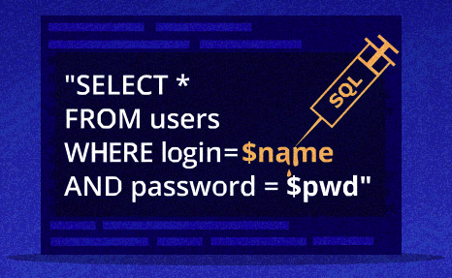

Security
1.User AUTHENTICATION
2.SQL INJECTION
Use Hashing Algorithms: Store passwords using strong, one-way hashing algorithms like bcrypt
Use Prepared Statements: Utilize prepared statements and parameterized queries for database interactions.

Slide 9


Security
3.Communication Channel
4.transaction
The project integrates a sandbox payment gateway known as 5BX. By using this sandbox gateway, we can mimic real-world payment conditions and results without involving actual financial transactions.
SSL/TLS: Encrypt data in transit by using HTTPS to protect against man-in-the-middle attacks.

Slide 10

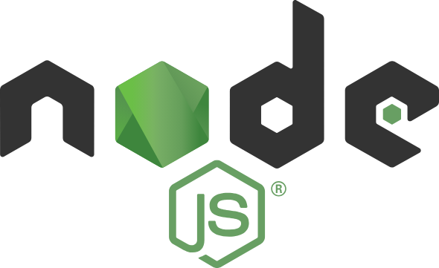



Server setup
01.
02.
03.
04.
05.
mYSQL
PHP
Apache server
npm
node
The MySQL is an open-source relational database management system.
The PHP is a general-purpose scripting language geared towards web development.
The Apache HTTP Server is a free and open-source cross-platform web server software.
The NPM is the default package manager for the JavaScript runtime environment.
The Node.js is a cross-platform, open-source JavaScript runtime environment.

Slide 11

Thank you
FOR
LISTENING

